Slide 1
University of Basrah Al-zahraa medical college
Ministry of higher Education and Scientific Researches
The module: URINARY SYSTEM MODULE
Session 3 Lecture 1
MODULE STAFF:
Prof.Mahmood Shakir Dr.Adnan Othafa
Ass.Prof.Firas Shakir Dr. Safaa Almatook Dr.Khaldoon Sadek
GLOMERULAR FILTRATION
For more detailed instruction, any question, cases need help please post to the group of session.

Slide 2
1-the function of each part of the nephron in the proess of filtration 2-transport types ,osmotic ,active ,reabsorption and excretion 3-GFR and clearance
University of Basrah Al-zahraa medical college
Ministry of higher Education and Scientific Researches
Aims &Learning out come
For more detailed instruction, any question, cases need help please post to the group of session.

Slide 3
Is it important to have the filtration function of the nephron? The body get rid of urea through fitration urea easly pass through cell membranes normaly 120ml\min of filtrate(80-125) about 7.2L\hour ,180L\day
University of Basrah Al-zahraa medical college
Ministry of higher Education and Scientific Researches
LO1
For more detailed instruction, any question, cases need help please post to the group of session.

Slide 4
each kidney has 1-1.2 milin nephron each nephron is formed by the glomerulus and the tubules afferant arterioles larger diameter than efferent arterioles filtrate pass through vessel endothelium ,basement membrane and podocytes to the tubular system by the effect of 1-blood hydrostatic pressure 2-tubular hydrostatic pressure 3-net difference of the osmotic pressure 4-the diameter of the filtered substance 5-the ionic charge most if not all H2O,urea,salts and glucose cells and protiens mostly not filtrated
University of Basrah Al-zahraa medical college
LO1
For more detailed instruction, any question, cases need help please post to the group of session.

Slide 5
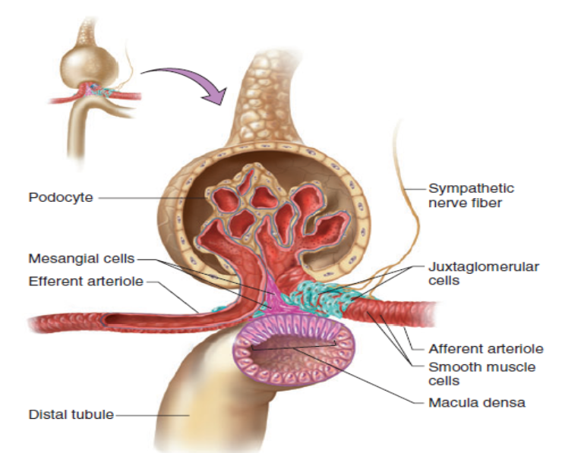
University of Basrah Al-zahraa medical college
Ministry of higher Education and Scientific Researches
LO2
For more detailed instruction, any question, cases need help please post to the group of session.

Slide 6
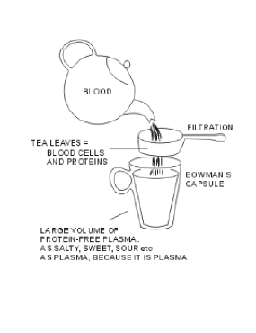
University of Basrah Al-zahraa medical college
Ministry of higher Education and Scientific Researches
LO2
For more detailed instruction, any question, cases need help please post to the group of session.

Slide 7
Hydrostatic pressure is the key role of filtration since H2O,glucose ,urea ,electrolytes and amino acids has a diameter less than 7nm all can filter easily depending on the hydrostatic pressure in the blood vessels ,this pressure is controlled by the properties of afferent arterioles to dilate and the efferent arterioles to constrict leading to a rise in hydrostatic pressure, in compare to the low pressure in the tubular system system .
University of Basrah Al-zahraa medical college
Ministry of higher Education and Scientific Researches
LO1
For more detailed instruction, any question, cases need help please post to the group of session.

Slide 8
Oncotic pressure derived from the osmotic pressure gradient is the second important factor controling filtration it starts low at the afferant arterioles gradually increasing due to loss of water and electrolytes up to a level that stop filtration at the efferent side
University of Basrah Al-zahraa medical college
Ministry of higher Education and Scientific Researches
LO2
For more detailed instruction, any question, cases need help please post to the group of session.

Slide 9
University of Basrah Al-zahraa medical college
Ministry of higher Education and Scientific Researches
LO2
For more detailed instruction, any question, cases need help please post to the group of session.

Slide 10
GFR Glomerular filtration rate defention:it is the rate at which filtrate flows out of the glomerular capillary loopacross the basement membrane into the tubules. The unit is volume\unit time. It reflect the efficacy by which the body filtrate out fluid and excrete waste products.
University of Basrah Al-zahraa medical college
Ministry of higher Education and Scientific Researches
LO2
For more detailed instruction, any question, cases need help please post to the group of session.

Slide 11
Gow can you measure GFR? You should chose asubstance that is filtered completely in the glomeruli ,it should not be reabsorbed nor secreted in this condition the mass is constant so by mesuring the density in both blood and urine with the volume of urine we can estimate the volume of plasma that was carrying the substance and filtered through the glomeruli i.e. GFR Density =mass\volume so mass =density * volume as the mass is fixed so mass in blood =mass in urine by sub density in blood*volume blood=density urine*volume urine volume of blood (GFR)=density urine*volume urine/density blood the substance used is Inulin
University of Basrah Al-zahraa medical college
Ministry of higher Education and Scientific Researches
LO2
For more detailed instruction, any question, cases need help please post to the group of session.

Slide 12
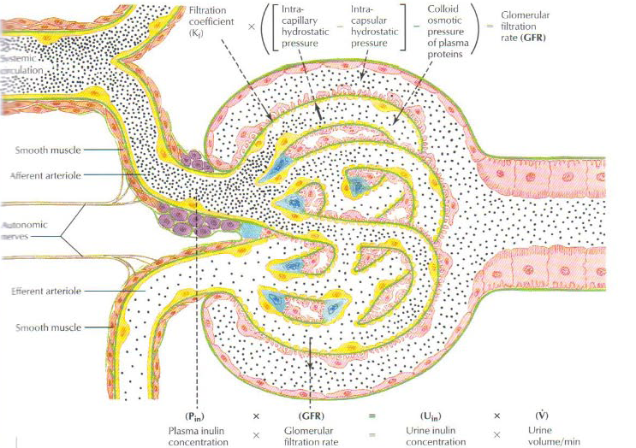
University of Basrah Al-zahraa medical college
Ministry of higher Education and Scientific Researches
LO2
For more detailed instruction, any question, cases need help please post to the group of session.

Slide 13
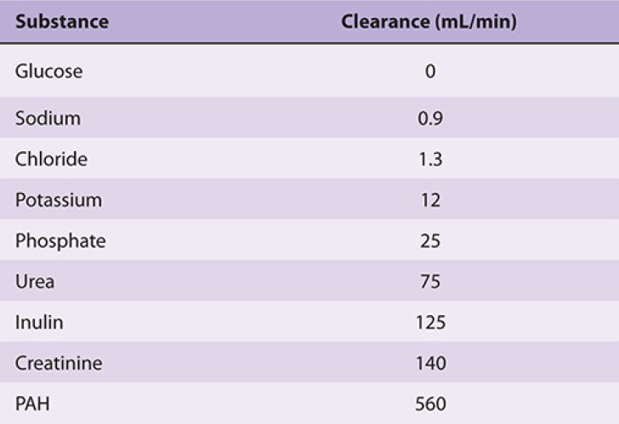
University of Basrah Al-zahraa medical college
Ministry of higher Education and Scientific Researches
LO2
For more detailed instruction, any question, cases need help please post to the group of session.

Slide 14
Factors controlling GFR size of cpillery bed =1m2, permeablity of capillary 50 times mre than normal, diameter 4-8 nm charge the endothilium is negative charge pressure ---blood and tubule osmotic----- in plasma and in urine
University of Basrah Al-zahraa medical college
Ministry of higher Education and Scientific Researches
LO2
For more detailed instruction, any question, cases need help please post to the group of session.

Slide 15
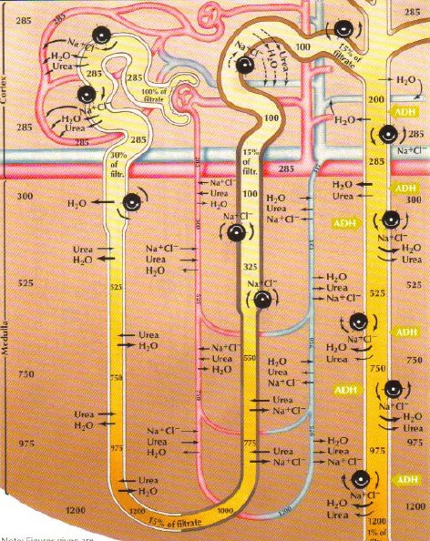
University of Basrah Al-zahraa medical college
Ministry of higher Education and Scientific Researches
LO2
For more detailed instruction, any question, cases need help please post to the group of session.

Slide 16
Tubular functions 1-proximal convoluted tubules it reabsorb water 130 L of the 180 L \day length about 15 mm mostly in the cortex also absorb Na,Cl,glucose,bicarb,phosphate
University of Basrah Al-zahraa medical college
Ministry of higher Education and Scientific Researches
LO2
For more detailed instruction, any question, cases need help please post to the group of session.

Slide 17
2- descending limb of loop of Henle absorb water 30 L but in passive way depending on permeablity and osmosis since it dip down the medulla which has high osmotic property so it is concentrating segment
University of Basrah Al-zahraa medical college
Ministry of higher Education and Scientific Researches
LO2
For more detailed instruction, any question, cases need help please post to the group of session.

Slide 18
3-ascending limb of loop of Henle no water absorption impermeabl to water the thick ascending part extract particles like Na,Cl,bicarb so it is diluting segment
University of Basrah Al-zahraa medical college
Ministry of higher Education and Scientific Researches
For more detailed instruction, any question, cases need help please post to the group of session.

Slide 19
4-distal convoluted tubule start at macula densa to connect the ascending limb to the collecting duct it is impermeable to water only 5% of Na is absorbed
University of Basrah Al-zahraa medical college
Ministry of higher Education and Scientific Researches
For more detailed instruction, any question, cases need help please post to the group of session.

Slide 20
5- collecting duct function to adjust the concentrating property of the kidney according to many factors ,it can either make urine more concentrated by absorbing water or more diluted by stopping the same process controlling Na reabsorption and control of H + ion
University of Basrah Al-zahraa medical college
Ministry of higher Education and Scientific Researches
LO2
For more detailed instruction, any question, cases need help please post to the group of session.

Slide 21
Autoregulation pressure sensor electrolyte sensor osmotic sensor
University of Basrah Al-zahraa medical college
Ministry of higher Education and Scientific Researches
LO2
For more detailed instruction, any question, cases need help please post to the group of session.

Slide 22
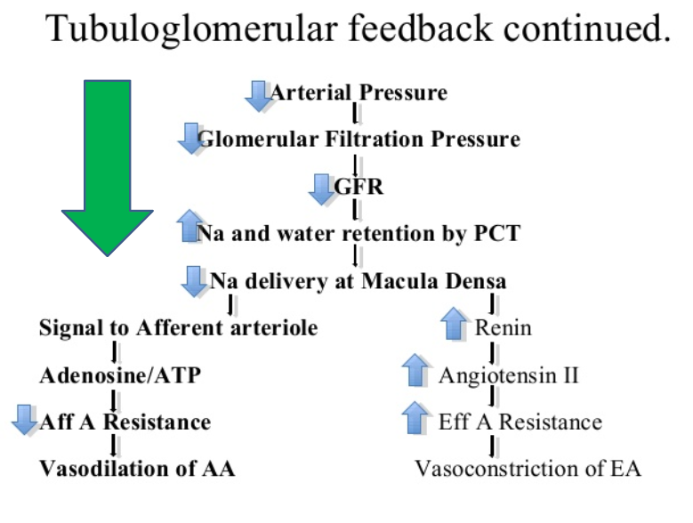
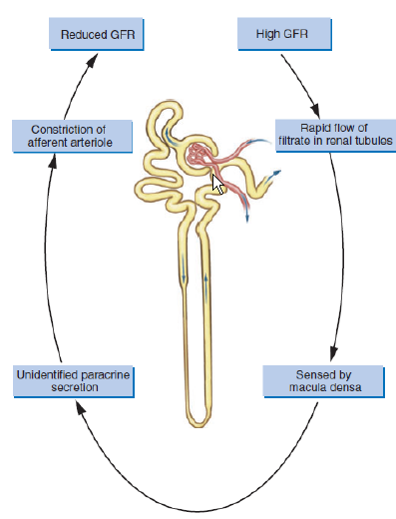
University of Basrah Al-zahraa medical college
Ministry of higher Education and Scientific Researches
LO2
For more detailed instruction, any question, cases need help please post to the group of session.

Slide 23
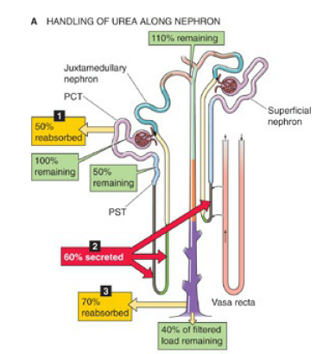
University of Basrah Al-zahraa medical college
Ministry of higher Education and Scientific Researches
LO2
For more detailed instruction, any question, cases need help please post to the group of session.

Slide 24
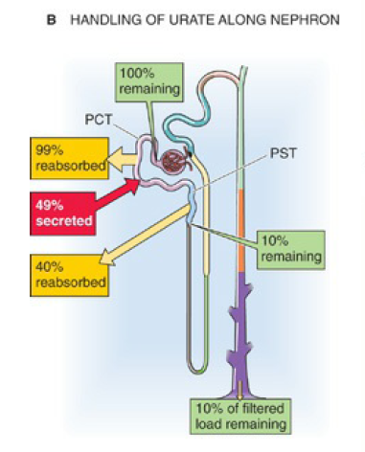
University of Basrah Al-zahraa medical college
Ministry of higher Education and Scientific Researches
LO2
For more detailed instruction, any question, cases need help please post to the group of session.

Slide 25
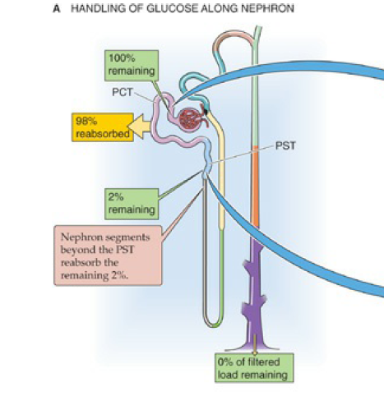
University of Basrah Al-zahraa medical college
Ministry of higher Education and Scientific Researches
LO2
For more detailed instruction, any question, cases need help please post to the group of session.

Slide 26
University of Basrah Al-zahraa medical college
Ministry of higher Education and Scientific Researches
LO2
For more detailed instruction, any question, cases need help please post to the group of session.

Slide 27
University of Basrah Al-zahraa medical college
Ministry of higher Education and Scientific Researches
LO2
For more detailed instruction, any question, cases need help please post to the group of session.

Slide 28
University of Basrah Al-zahraa medical college
Ministry of higher Education and Scientific Researches
LO2
For more detailed instruction, any question, cases need help please post to the group of session.

Slide 29
University of Basrah Al-zahraa medical college
Ministry of higher Education and Scientific Researches
LO2
For more detailed instruction, any question, cases need help please post to the group of session.

